Slide 1
COSC 2430
Lab 10/28/2019

Slide 2
Book Exercise
Goodrich, M. T., Tamassia, R., Goldwasser, M. H. Data Structures and Algorithms in Java. Wiley, 6th edition, 2016

Slide 3
Chapter 8:Trees
R-8.1 The following questions refer to the tree of Figure 8.3.
Which node is the root?
What are the internal nodes?
How many descendants does node cs016/ have?
How many ancestors does node cs016/ have?
What are the siblings of node homeworks/?
Which nodes are in the subtree rooted at node projects/?
What is the depth of node papers/?
h. What is the height of the tree?

Slide 4
Chapter 8:Trees

Slide 5
Chapter 8:Trees
What is the pre-order, in-order and post-order traversals of the trees in Fig. 8.10, Fig 8.11.

Slide 6
Chapter 8:Trees

Slide 7
Chapter 8:Trees
R-8.22 Draw a binary tree T that simultaneously satisfies the following:
• Each internal node of T stores a single character.
• A preorder traversal of T yields EXAMFUN.
• An inorder traversal of T yields MAFXUEN.

Slide 8
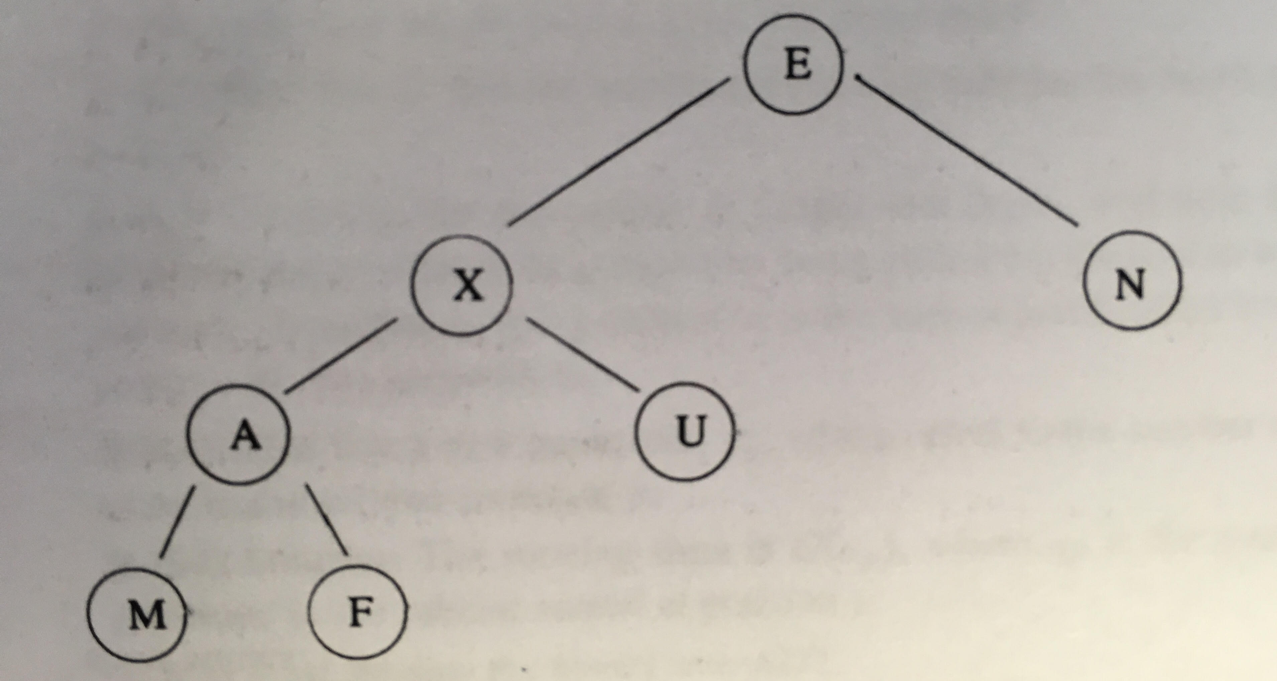
Chapter 8:Trees

Slide 9
Chapter 10:Maps, Hash Tables
A hash function h maps keys of a given type to integers in a fixed interval [0, N − 1]
Example: h(x) = x mod N is a hash function for integer keys
The integer h(x) is called the hash value of key x
A hash table for a given key type consists of
Hash function h
Array (called table) of size N
When implementing a map with a hash table, the goal is to store item (k, o) at index i = h(k)

Slide 10
Collision Handling
Collisions occur when different elements are mapped to the same cell
Separate Chaining: let each cell in the table point to a linked list of entries that map there
0
∅
1
025-612-0001
2
∅
3
∅
4
451-229-0004
981-101-0004
Separate chaining is simple, but requires additional memory outside the table

Slide 11
Map with Separate Chaining
Delegate operations to a list-based map at each cell:
Algorithm get(k):
return A[h(k)].get(k)
Algorithm put(k,v):
t = A[h(k)].put(k,v)
if t = null then {k is a new key}
n = n + 1
return t
Algorithm remove(k):
t = A[h(k)].remove(k)
if t ≠ null then {k was found}
n = n - 1
return t

Slide 12
Chapter 10: UnsortedTableMap

Slide 13
Chapter 10: UnsortedTableMap

Slide 14
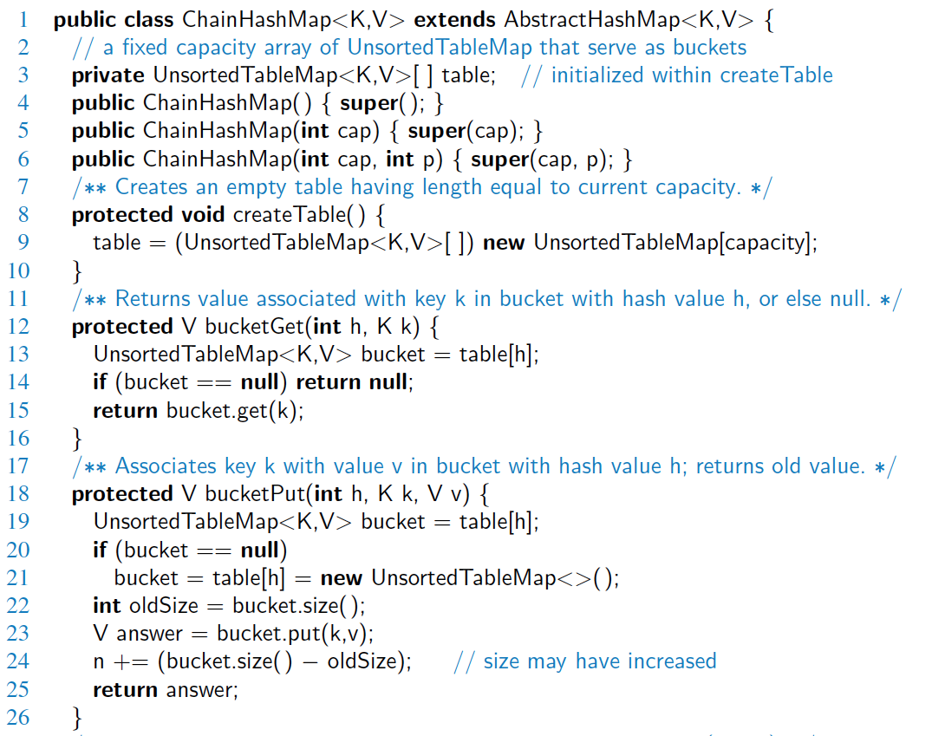
Hash Table with Chaining

Slide 15
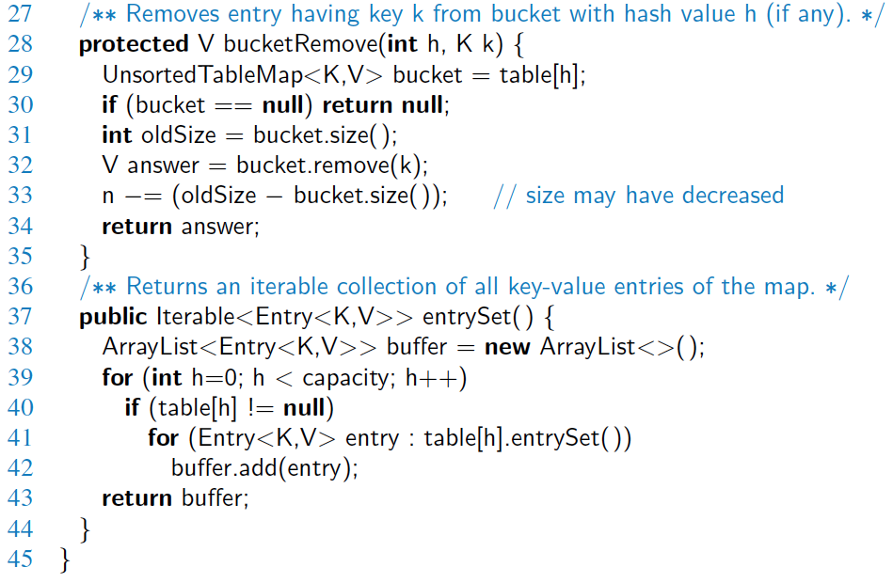
Hash Table with Chaining, 2

Slide 16
Chapter 10:Maps, Hash Tables
R-10.6 Draw the 11-entry hash table that results from using the hash function, h(i) = (3i+5) mod 11, to hash the keys 12, 44, 13, 88, 23, 94, 11, 39, 20, 16, and 5, assuming collisions are handled by chaining.

Slide 17
Chapter 10:Maps, Hash Tables
R-10.6 Draw the 11-entry hash table that results from using the hash function, h(i) = (3i+5) mod 11, to hash the keys 12, 44, 13, 88, 23, 94, 11, 39, 20, 16, and 5, assuming collisions are handled by chaining.
Insert 12:
K=12, h(12)= (3*12 +5) mod 11 = 8 →
0 | 1 | 2 | 3 | 4 | 5 | 6 | 7 | 8 | 9 | 10
 |  |  |  |  |  |  |  | 12

Slide 18
Chapter 10:Maps, Hash Tables
R-10.6 Draw the 11-entry hash table that results from using the hash function, h(i) = (3i+5) mod 11, to hash the keys 12, 44, 13, 88, 23, 94, 11, 39, 20, 16, and 5, assuming collisions are handled by chaining.
0 | 1 | 2 | 3 | 4 | 5 | 6 | 7 | 8 | 9 | 10
13 | 94 39 |  |  |  | 44 88 11 |  |  | 12 23 | 16 5 | 20

Slide 19
Chapter 10:Maps, Hash Tables
R-10.7 What is the result of the previous exercise, assuming collisions are handled by linear probing?
Let's have a quick review …

Slide 20
Linear Probing
Linear probing: handles collisions by placing the colliding item in the next (circularly) available table cell
Each table cell inspected is referred to as a “probe”
Colliding items lump together, causing future collisions to cause a longer sequence of probes
Example:
h(x) = x mod 13
Insert keys 18, 41, 22, 44, 59, 32, 31, 73, in this order
0
1
2
3
4
5
6
7
8
9
10
11
12
41
18
44
59
32
22
31
73
0
1
2
3
4
5
6
7
8
9
10
11
12

Slide 21
Chapter 10:Maps, Hash Tables
R-10.7 What is the result of the previous exercise, assuming collisions are handled by linear probing?
h(i) = (3i+5) mod 11, to hash the keys 12, 44, 13, 88, 23, 94, 11, 39, 20, 16, and 5
Insert 12 : h(12) = 8
Insert 44: h(44)=5
Insert 13, h(13) =0
Insert 88, h(88) = 5 -> already occupied , next available cell: 6
0 | 1 | 2 | 3 | 4 | 5 | 6 | 7 | 8 | 9 | 10
13
44
88
12

Slide 22
Chapter 10:Maps, Hash Tables
R-10.7 What is the result of the previous exercise, assuming collisions are handled by linear probing?
h(i) = (3i+5) mod 11, to hash the keys 12, 44, 13, 88, 23, 94, 11, 39, 20, 16, and 5
0 | 1 | 2 | 3 | 4 | 5 | 6 | 7 | 8 | 9 | 10
13 | 94 | 39 | 16 | 5 | 44 | 88 | 11 | 12 | 23 | 20

Slide 23
Chapter 10:Maps, Hash Tables
R-10.9 What is the result of Exercise R-10.6 when collisions are handled by double hashing using the secondary hash function h2(k) = 7−(k mod 7)?
h(i) = (3i+5) mod 11, to hash the keys 12, 44, 13, 88, 23, 94, 11, 39, 20, 16, and 5
What was double hashing ?

Slide 24
Double Hashing
Double hashing uses a secondary hash function d(k) and handles collisions by placing an item in the first available cell of the series (i + jd(k)) mod N for j = 0, 1, … , N − 1
The secondary hash function d(k) cannot have zero values
The table size N must be a prime to allow probing of all the cells
Common choice of compression function for the secondary hash function:
d₂(k) = q − k mod q
where
q < N
q is a prime
The possible values for d₂(k) are 1, 2, … , q

Slide 25
Chapter 10:Maps, Hash Tables
R-10.9 What is the result of Exercise R-10.6 when collisions are handled by double hashing using the secondary hash function h2(k) = 7−(k mod 7)?
i=h(k) = (3k+5) mod 11, to hash the keys 12, 44, 13, 88, 23, 94, 11, 39, 20, 16, and 5
i2 = (h(k) + j * h2(k) mod 11)
For j =1,2, 3 , …
0 | 1 | 2 | 3 | 4 | 5 | 6 | 7 | 8 | 9 | 10
13 | 94 | 23 | 88 | 39 | 44 | 11 | 5 | 12 | 16 | 20

